Slide 1
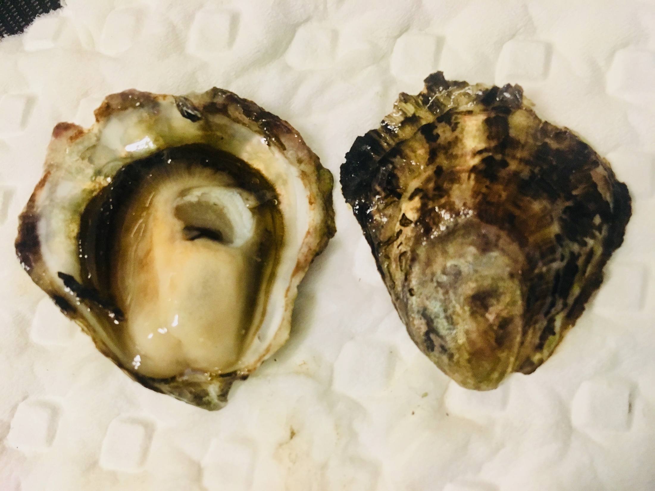
Breeding methods and genetic diversity in
native oysters
Laura Spencer¹ • Brent Vadopalas¹ • Crystal Simchick²
Ryan Crim³ • Stuart Ryan³ • Frederick Goetz² • Steven Roberts¹
University of Washington, Seattle
NOAA Aquaculture
Puget Sound Restoration Fund
Aquaculture America, February 2018
Notes:
Change the title

Slide 2
How to restore native oyster population, and DO NOT HARM?
Which breeding method results in the most genetic diversity?
Notes:
Question I’ll be addressing today,

Slide 3
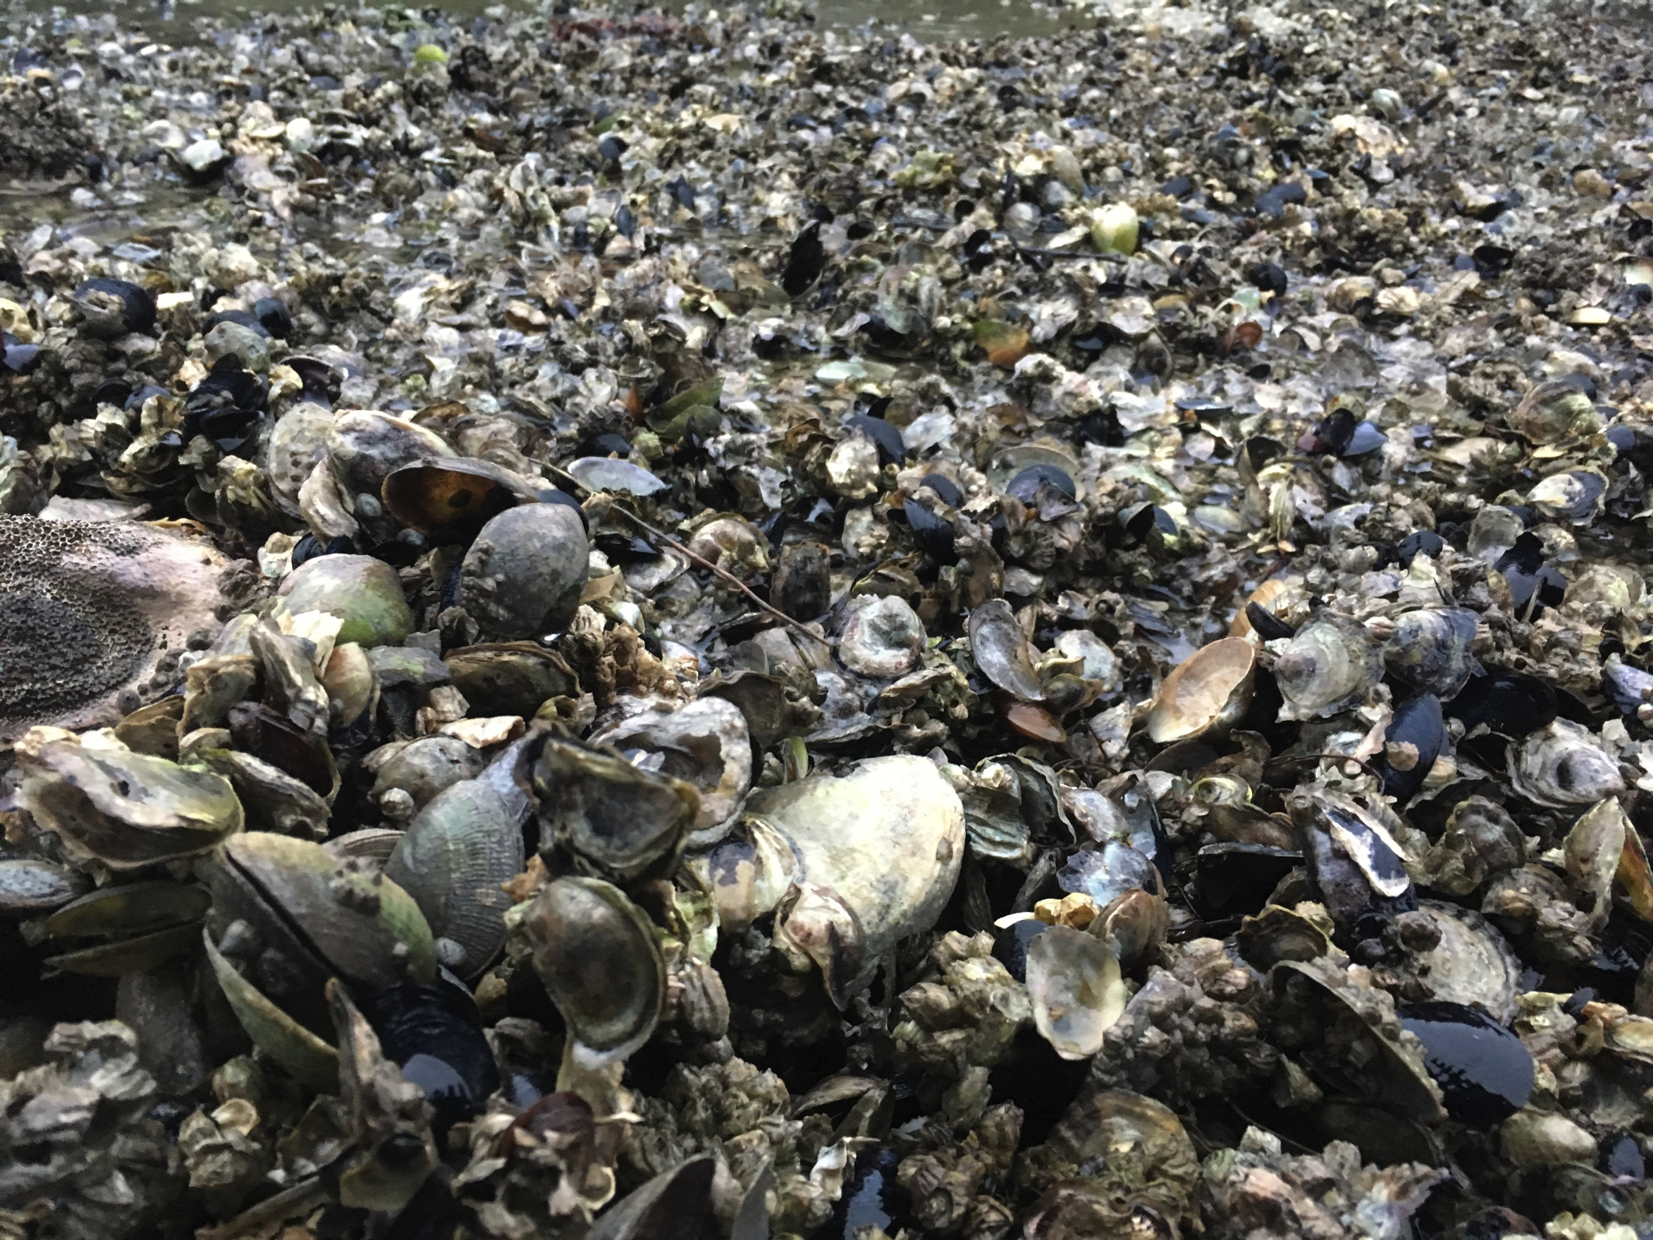
Genetic concerns in restoration breeding
Lack of diversity: producing only a few families
Mixing genetically distinct sub-populations that are locally adapted
Hatchery selection: traits beneficial in hatchery system amplified, but detrimental in natural system
How to breed oysters that are genetically indiscriminate from wild?
Notes:
Getting back to the DO NO HARM theme, a major focus in breeding these oysters has been to produce genetically resilient seed.
Genetic diversity is important when supplementing wild oysters, and there are three major outcomes that breeders needs to avoid:
Mixing sub-pops
Lack of diversity
Hatchery selection

Slide 4
Olympia oyster
Ostrea lurida
Notes:
On the screen is the Olympia oyster, these guys are an ostrea species …
Related to other flat oyster, such as European Flat Oyster, Ostrea edulis
Smaller oysters average size is ????
is the only oyster native to the Pacific Coast of North America.
Historic distribution spanned from BC down to Baja California

Slide 5
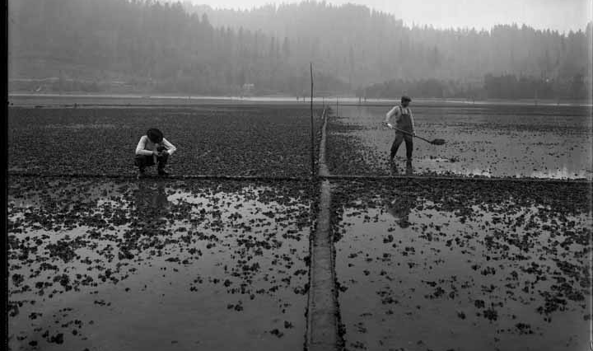
September, 1910, Brenner Oyster Company in Totten Inlet
Washington State Historic Society
Notes:
Once abundant, supported commercial industry from mid 1800’s to early 1900’s
It also is believe to have been a vital food source for ancient indigenous populations, because shell piles – called middens – have been unearthed during excavations.

Slide 6
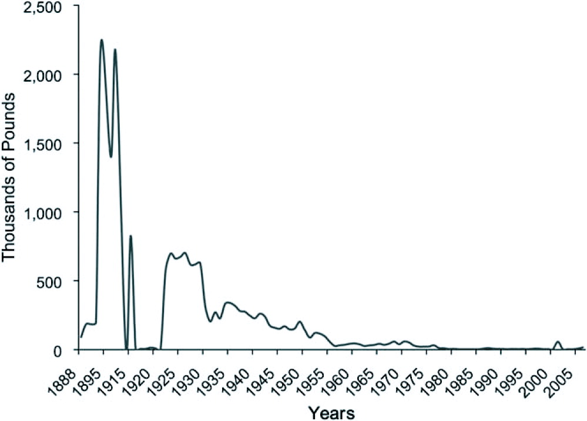
Olympia oyster populations declined rapidly in early 1900’s
White, Ruesink & Trimble, 2009
Notes:
However, beginning in the early 1900’s populations started to crash.
This figure shows the coast-wide commercial landings over time, in thousands of pounds.
Overharvest is considered the majorculprit, but development, pollution, and the introduction of the Pacific oyster in the 1920’s are also considered contributing factors
Once dense Olympia oyster beds have dwindled to 5% of historic abundance (WDFW, 2013)
Dispersed in pockets, once dense aggregates – very few, sparse beds remain

Slide 7
Restoration Strategies
Restrict harvest, shoreline development
Enhance natural recruitment
Collect oysters at healthy site, transfer to restoration site
Grow seed in hatchery, outplant
Notes:
We’ve one quite a number on the Olympia oyster. In the last decades, folks have started to try to restore pockets of populations
I’ve listed the major restoration strategies employed along the coast
Listed in order of least invasive to most invasive, most risky
Last resort: Hatchery method
Most of the restoration programs use strategies 1-3

Slide 8
Restoration Strategies
Restrict harvest, shoreline development
Enhance natural recruitment
Collect oysters at healthy site, transfer to restoration site
Grow seed in hatchery, outplant
Notes:
One program has resorted to strategy # 4 …

Slide 9
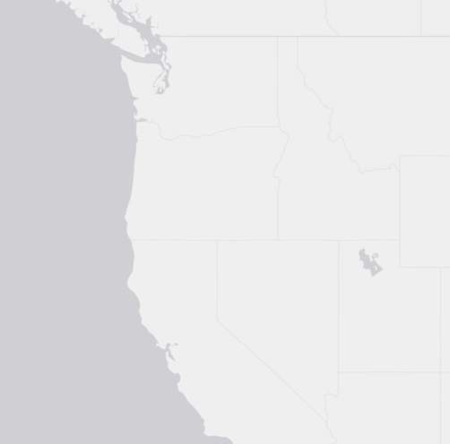
Puget Sound has the only Olympia oyster restoration hatchery
Peabody & Davis, Puget Sound Restoration Fund, 2015
Notes:
That’s the Puget Sound in WA State
The Puget Sound Olympia oyster restoration effort is the only program supplementing wild populations with hatchery produced seed.
Puget Sound has several pockets of remnant Olympia oyster populations – they are not connected, and many are unable to grow without the help of hatchery production. On the right is showing where Puget Sound is in relation to the Pacific Coast, and on the left are 19 locations of historic, dense beds, which are targeted for restoration.

Slide 10
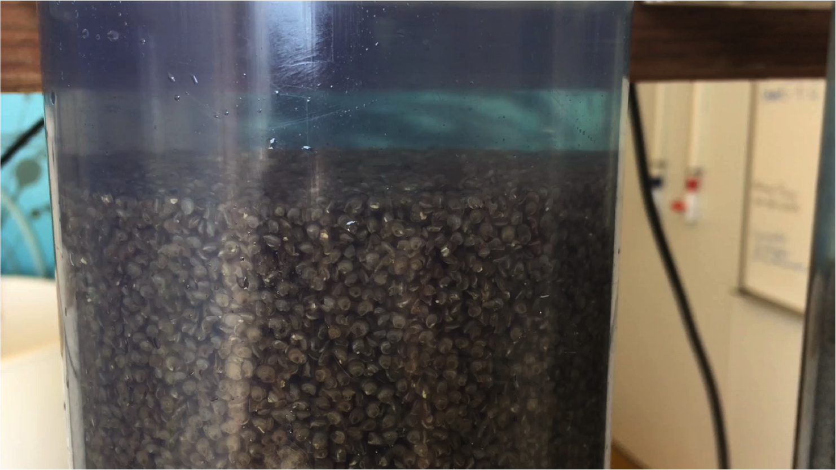
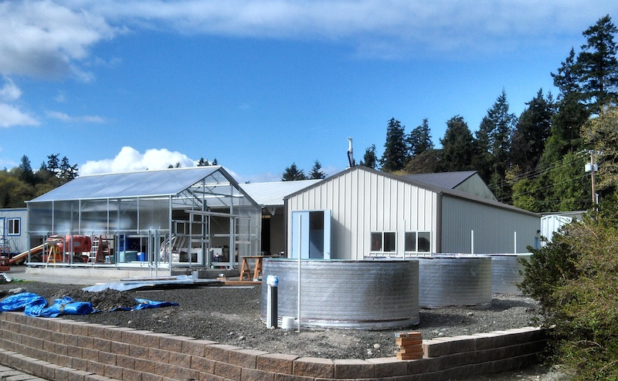
Hatchery production by Puget Sound Restoration Fund, NOAA
Notes:
A non-profit, the Puget Sound Restoration Fund, is group carrying out this restoration program. They have been producing seed since 2010, and in the 8 years since have grown considerably, and now operate out of a brand new hatchery on a NOAA research station. They have developed and refined practices specific to this species, and have become very successful.
2017 produced ~4.8 million Olympia oyster seed
They practice strict biosecurity protocols, they only breed oysters that have been collected from the same site, and only use sane broodstock once. They also do not strip spawn.

Slide 11
Question
How to restore native oyster population, and DO NOT HARM?
Which breeding method results in the highest genetic diversity?
Notes:
I’m going to show you a couple different breeding methods, and have you predict which one produces oysters with greater genetic diversity.
Before I do, I’ll briefly describe the genetic tool that we have used in this project.
Microsatellite markers were used to measure how effective the breeding methods are at maintaining diversity.
Microsatellites are useful for genotyping. They are basically very short DNA sequences that are repeated, and the number of times they repeat are genetically passed between generations, and we call this an allele (or trait – much like eye color, but without a physical diff). Microsatellite are a relatively cheap way to do genetic testing. They are often used in paternity tests, and forensic.
Now that you have an idea what tool we are using, I’m going to show you 2 different breeding methods that we have used, and then I’ll take a poll to see which one you think produces more diverse oysters.

Slide 12
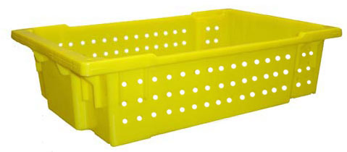
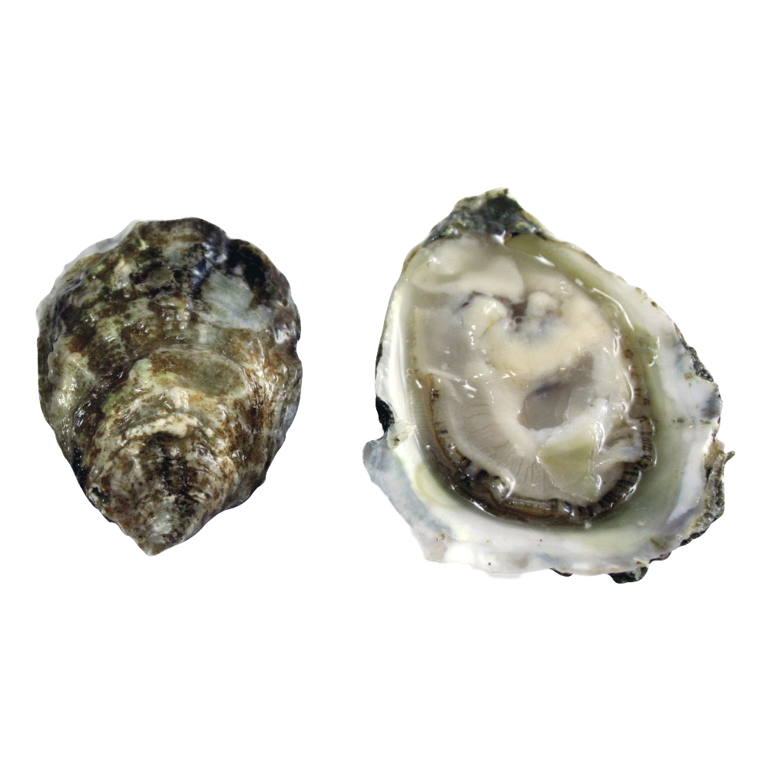
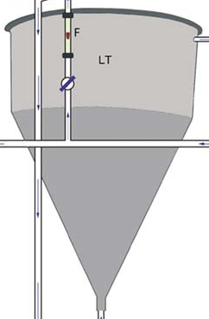
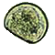
Breeding method A
N=~1,500 broodstock
Mass volitional spawn, no larvae separated
Notes:
Breeding method A: mass volitional spawning
All broodstock go into one large tank, the oysters induced to spawn over ~1-2 months, and hatchery staff collects larvae.
No control over the number of crosses, and therefore larvae are not grown in separate families

Slide 13
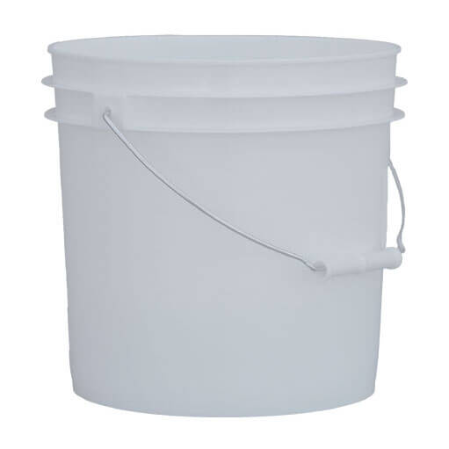
Breeding method B
n=~25 brood-stock per family
…
Family 1
Family 2
Family 3
Family 20
…
Separated broodstock & larvae
Notes:
Breeding method B: spawns in 10 families, with 20-25 oysters per family.
Larvae are also reared separately, by family.
How many of you think that method B produces seed with higher genetic diversity? More families?

Slide 14
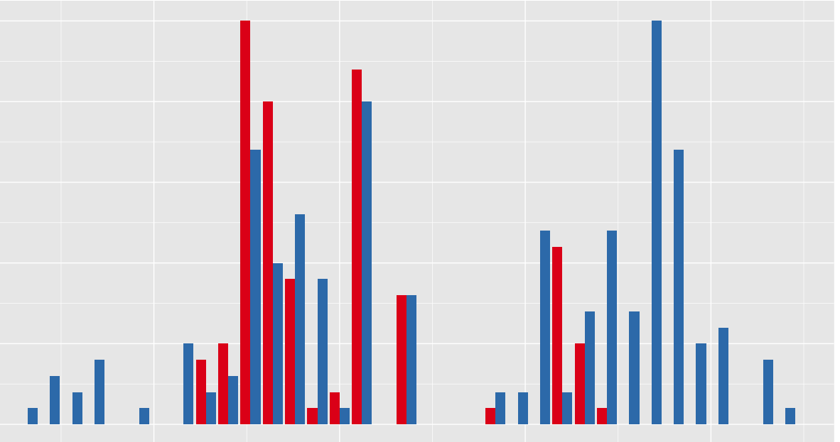
Hypothetical Wild vs. Hatchery less diversity compared to wild
20
Frequency in Population
10
0
200 225 250 275 300 325
Allele Size (# base pairs)
Notes:
Here is histogram of microsatellite markers data, where diversity is very poor compared to wild stock. Worst case scenario all are brothers & sisters (2 alleles) Best case scenario, looks same as wild.

Slide 15
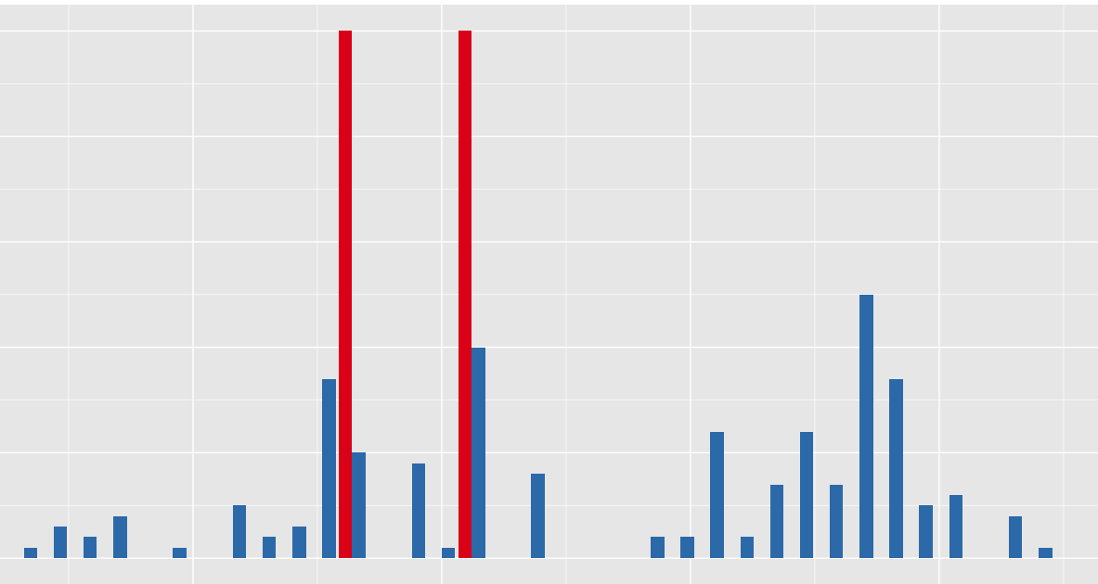
Hypothetical Wild vs. Hatchery (F1) all siblings
50
40
30
Frequency in Population
20
10
0
200 225 250 275 300 325
Allele Size (# base pairs)
Notes:
Here is histogram of microsatellite markers data, where diversity is very poor compared to wild stock. Worst case scenario all are brothers & sisters (2 alleles) Best case scenario, looks same as wild.

Slide 16
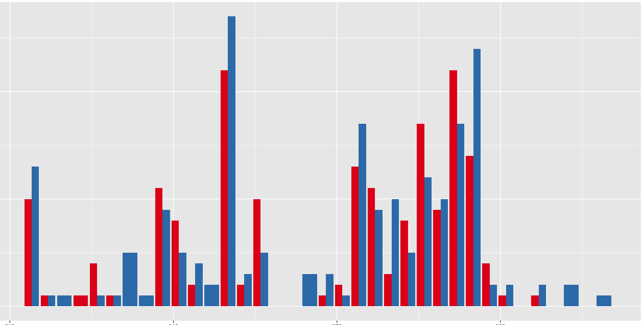
2014 “Bucket” Wild vs. Hatchery (F1)
30
20
Frequency in Population
10
0
210 240 270 300 320
Allele Size (# base pairs)
Notes:
For those of you familiar with microsatellite testing, here’s the frequency distribution of alleles for one of the microsatellite loci; what we’re looking for is a similar distribution for both hatchery & wild, with equal variance.

Slide 17
Microsatellites informed breeding methods
2014 Seed vs. Wild
P-value across all loci
(Fisher's method)
------------- --------
Olur10 0.23431
Olur11 0.08533
Olur12 0.3782
Olur13 0.00006*
Olur15 0.00009*
Olur17 0.78623
Olur18 0.00423*
All: Chi2= 39.524 (df= 14) P-value= 0.000000158
Family 1
Family 2
Family 3
2010-2014 Separated broodstock & larvae
Notes:
This bucket method was actually used first few years of the program, 2010-2014, and microsatellite testing showed that it was not producing offspring as diverse as wild.

Slide 18
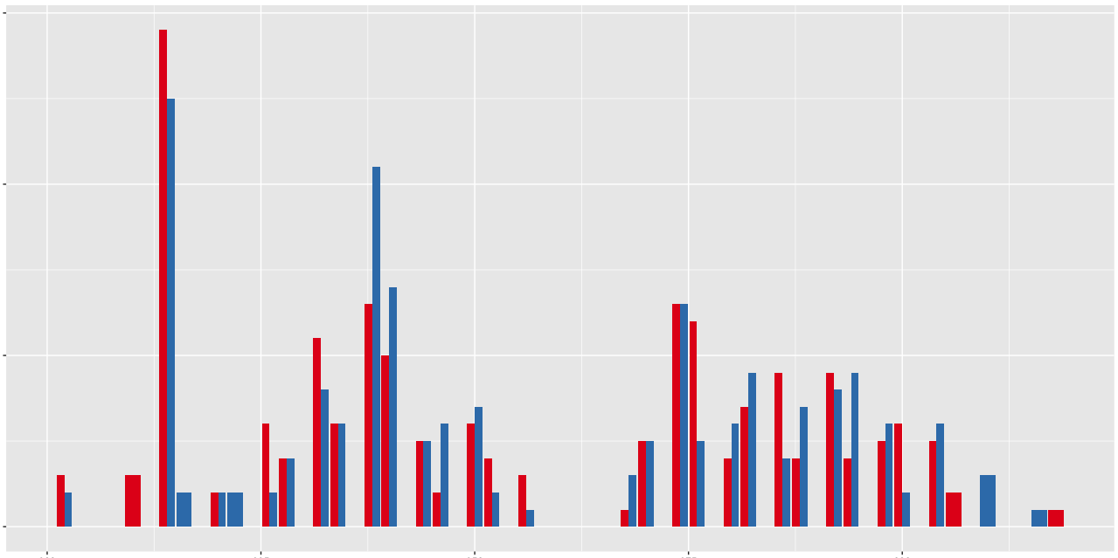
2016 “Mass Volitional” Wild vs. Hatchery (F1)
30
20
Frequency in Population
10
0
200 225 250 275 300 325
Allele Size (# base pairs)
Notes:
For those of you familiar with microsatellite testing, here’s the frequency distribution of alleles for one of the microsatellite loci; what we’re looking for is a similar distribution for both hatchery & wild, with equal variance.

Slide 19
Microsatellites informed breeding methods
2016 Seed vs. Wild
P-value across all loci
(Fisher's method)
-------------------------------------Locus P-Value
------------- --------
Olur10 0.32784
Olur11 0.54191
Olur12 0.67662
Olur13 0.08560
Olur15 0.06505
Olur19 0.01146
All: Chi2= 18.39076 (df= 12) P-value= 0.104331
Mass spawn, collected for 4+ weeks,
2014-today separated larvae based on capacity

Slide 20
Lessons
Genetic testing informed breeding methods
Better method: Mass volitional spawn
Added benefit: less labor, resources
Caveats
No guarantee from year to year
Not directly assessing hatchery selection
More robust testing soon! (SNP testing)

Slide 21
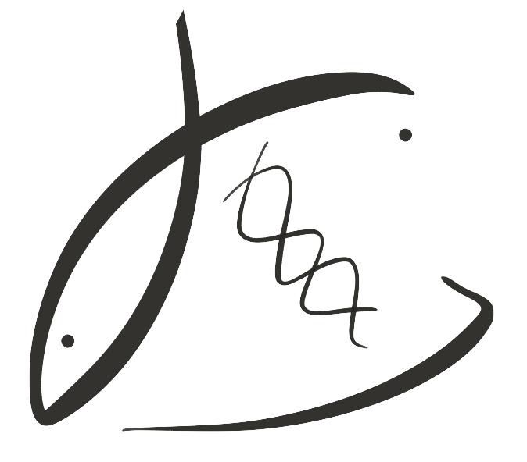



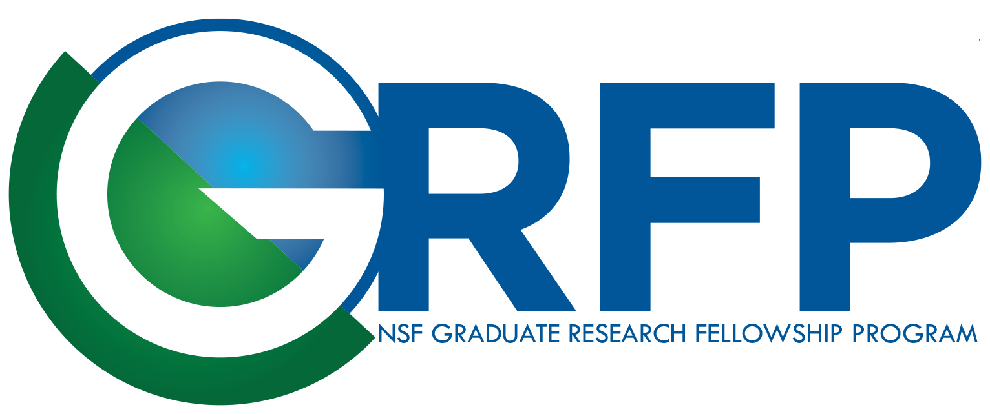
Thank you
USAS & WAC
NSF GRFP
NOAA & PSRF
Roberts Lab @ UW
UW CoEnv travel award
Notes:
Change the title

Slide 22
BONEYARD

Slide 23
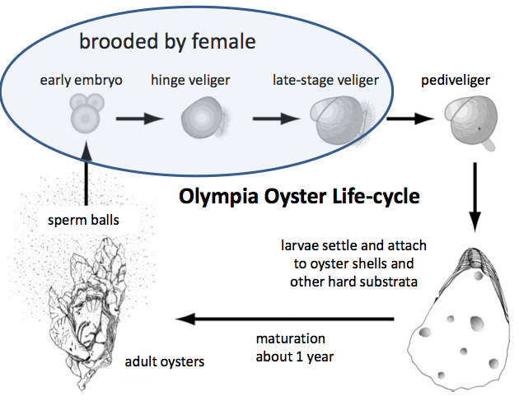
Larvae brooded to pediveliger stage
Notes:
Before I continue = quick lesson on the olympia oyster life cycle
Females are brooders. Females do not broadcast spawn their eggs, but males do. Males release sperm, females filter them in and fertilize their eggs, then the embryos develop, larvae are maintained by the female in their mantle cavity until they have a fully formed shell, then they are released into the water.

Slide 24
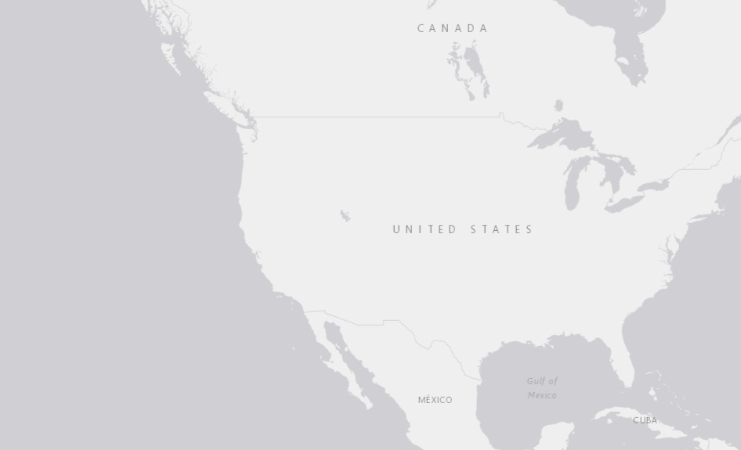
Historic Olympia oyster distribution
Adapted from McGraw, 2009
Notes:
CHANGE:
Different image
Show where populations are now
This is where Puget Sound is, WA state
Citation texts way too big

Slide 25
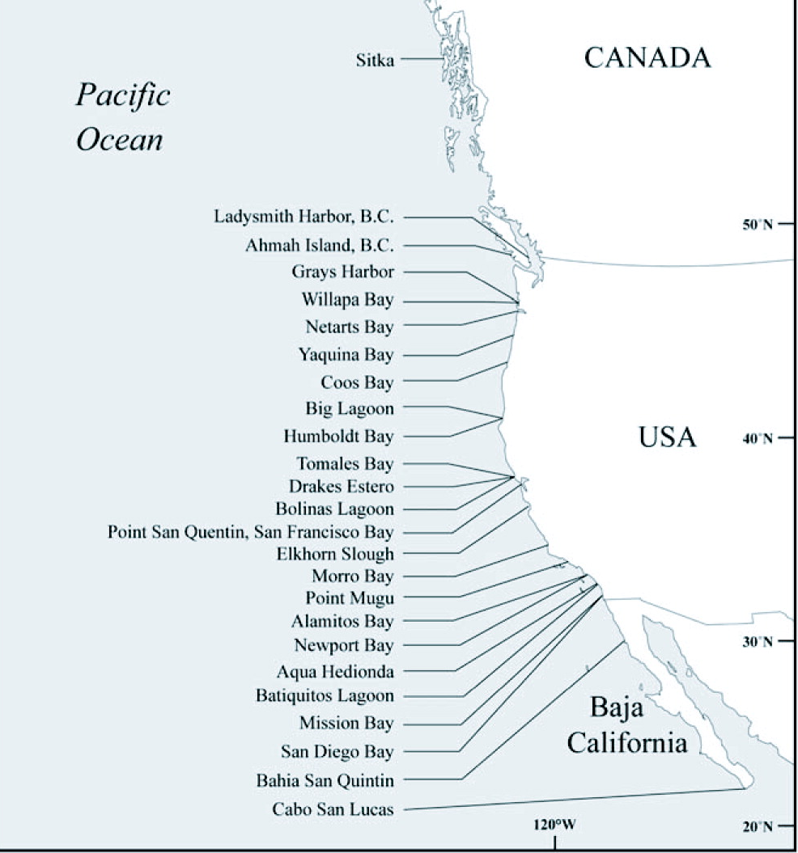
2005/2006 Surveys, Olympia oyster distribution
All Absent
Intertidal Absent
Present
Adapted from Polson & Zacherl, 2009
Notes:
Survey: intertidal populations at 24 historical sites to establish presence/absence, density & % cover data. Average MAX DENSITIES ranged from 0.0–36.7 ± 12.1 oysters per 0.25 m2. In southern California, intertidal populations were present in all bays and estuaries south of Morro Bay and most showed evidence of regular recruitment. Thus, all southern California sites could present favorable opportunities for restoration projects. At the north end of the range, intertidal populations were more often absent from sites, though there was evidence of subtidal populations.
We’ve one quite a number on the Olympia oyster. In the last few decades, folks have started to try to restore pockets of populations.

Slide 26
Microsatellites informed breeding methods
2011 Seed vs. Wild
P-value across all loci
(Fisher's method)
-------------------------------------Locus P-Value
------------- --------
Olur10 0.00663
Olur11 0.22946
Olur12 0.01095
Olur13 0.01624
Olur15 0.00054
Olur17 0.00011
Olur18 0.09468
All: Chi2= 68.2382 (df= 14) P-value= 4.01679e-09
Day 1
Day 2
Day 3
2011 Mass spawn, separated larvae by daily collections

Slide 27
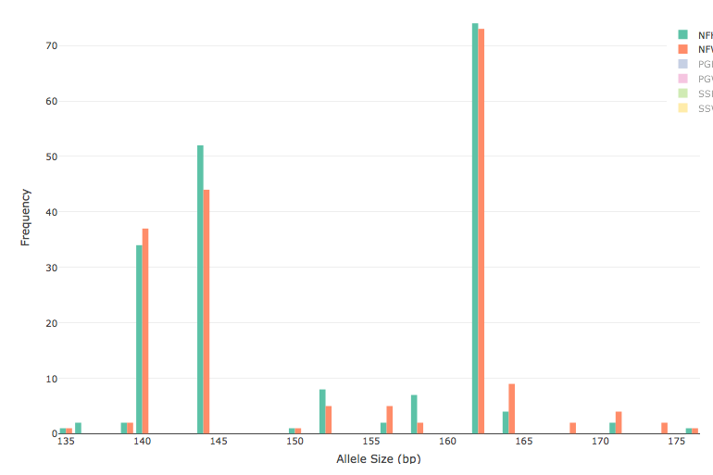
2016 Hatchery vs. Wild
Orange = Wild
Green = Hatchery F1
Locus “Olur11”

Slide 28
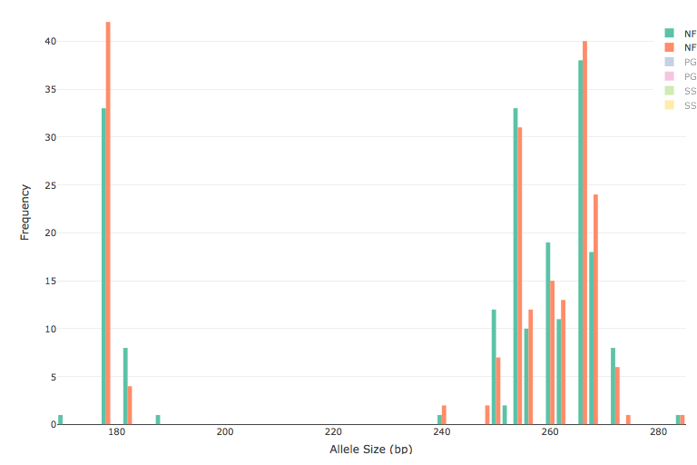
2016 Hatchery vs. Wild
Orange = Wild
Green = Hatchery F1
Locus “Olur12”

Slide 29
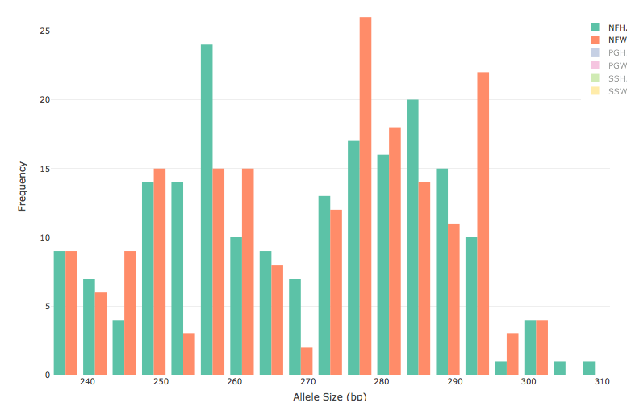
2016 Hatchery vs. Wild
Orange = Wild
Green = Hatchery F1
Locus “Olur13”

Slide 30
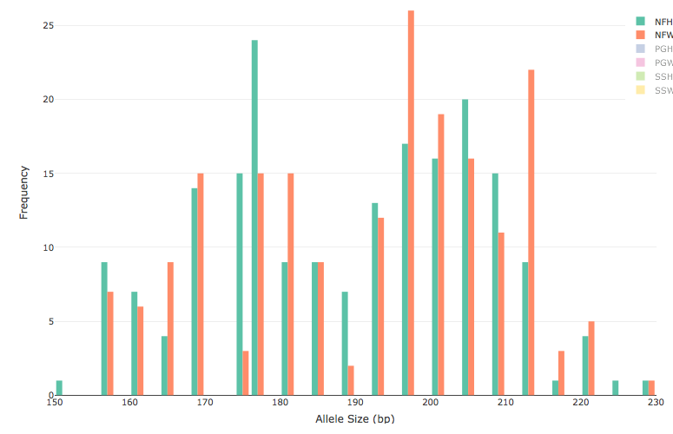
2016 Hatchery vs. Wild
Orange = Wild
Green = Hatchery F1
Locus “Olur15”

Slide 31
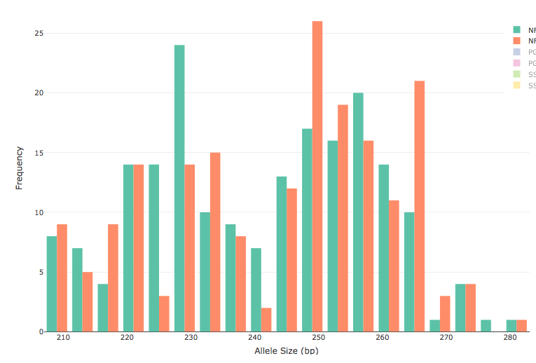
2016 Hatchery vs. Wild
Orange = Wild
Green = Hatchery F1
Locus “Olur19”

